Slide 1
eatables
eatables
eatables
eatables
eatables
eatables
eatables
eatables
eatables
eatables
eatables
eatables
eatables
eatables
eatables
eatables
eatables
eatables
eatables
eatables
eatables
eatables
eatables
eatables
eatables
eatables
eatables
eatables
eatables
eatables
eatables
204682 – Ashwin K.V
204683 – Darshan Dinesh M.P
204684 – Delbin George
eatables
eatables
eatables
eatables
eatables
eatables
eatables
eatables
eatables
eatables
eatables
eatables
eatables
eatables

Slide 2




DOCUMENTATIONS
eatables
eatables
eatables
eatables
eatables
eatables
eatables
eatables
eatables
eatables
eatables
eatables
INTRODUCTION
CONCLUSION
eatables
eatables
eatables
eatables
eatables
eatables
eatables
eatables
eatables
eatables
eatables
eatables
eatables
eatables
eatables
eatables
eatables
eatables
eatables
eatables
eatables
204682 – Ashwin K.V
204683 – Darshan Dinesh M.P
204684 – Delbin George
eatables
eatables
eatables
eatables
eatables
eatables
eatables
eatables
eatables
eatables
eatables
eatables
KEY FEATURES

Slide 3
eatables
eatables
eatables
eatables
eatables
eatables
eatables
eatables
eatables
eatables
eatables
eatables
eatables
eatables
eatables
eatables
eatables
EATABLES is a dynamic and user-friendly platform that provides a convenient way for food lovers to discover new dining options. With features like location-based restaurant recommendation, user reviews, personalized favorites lists, vlog uploads, and filtered search results, By creating a community-driven approach, EATABLES fosters engagement and encourages users to share their dining experiences and recommendations with others.
eatables
eatables
eatables
eatables
INTRODUCTION
KEY FEATURES
DOCUMENTATIONS
CONCLUSION
eatables
eatables
eatables
eatables
eatables
eatables
eatables
eatables
eatables
eatables
eatables
eatables
eatables
eatables
eatables
eatables
eatables
eatables
eatables
eatables
204682 – Ashwin K.V
204683 – Darshan Dinesh M.P
204684 – Delbin George
eatables
eatables
eatables
eatables

Slide 4
eatables
eatables
eatables
eatables
KEY FEATURES
CONCLUSION
DOCUMENTATIONS
eatables
eatables
eatables
eatables
eatables
INTRODUCTION
eatables
eatables
eatables
eatables
EATABLES is a dynamic and user-friendly platform that provides a convenient way for food lovers to discover new dining options. With features like location-based restaurant recommendation, user reviews, personalized favorites lists, vlog uploads, and filtered search results, By creating a community-driven approach, EATABLES fosters engagement and encourages users to share their dining experiences and recommendations with others.
eatables
eatables
eatables
eatables
eatables
eatables
eatables
eatables
eatables
eatables
eatables
eatables
eatables
eatables
eatables
eatables
eatables
eatables
eatables
eatables
eatables
eatables
eatables
eatables
eatables
eatables
eatables
eatables
eatables
eatables
eatables
eatables

Slide 5
eatables
eatables
eatables
eatables
eatables
eatables
eatables
eatables
eatables
eatables
eatables
eatables
eatables
eatables
eatables
eatables
eatables
EATABLES is a dynamic and user-friendly platform that provides a convenient way for food lovers to discover new dining options. With features like location-based restaurant recommendation, user reviews, personalized favorites lists, vlog uploads, and filtered search results, By creating a community-driven approach, EATABLES fosters engagement and encourages users to share their dining experiences and recommendations with others.
INTRODUCTION
KEY FEATURES
DOCUMENTATIONS
CONCLUSION
eatables
eatables
eatables
eatables
eatables
eatables
eatables
eatables
eatables
eatables
eatables
eatables
eatables
eatables
eatables
eatables
eatables
eatables
eatables
eatables
204682 – Ashwin K.V
204683 – Darshan Dinesh M.P
204684 – Delbin George
eatables
eatables
eatables
eatables
eatables
eatables
eatables
eatables

Slide 6
eatables
eatables
eatables
eatables
eatables
eatables
eatables
eatables
eatables
eatables
eatables
eatables
eatables
eatables
eatables
eatables
eatables
EATABLES is a dynamic and user-friendly platform that provides a convenient way for food lovers to discover new dining options. With features like location-based restaurant recommendation, user reviews, personalized favorites lists, vlog uploads, and filtered search results, By creating a community-driven approach, EATABLES fosters engagement and encourages users to share their dining experiences and recommendations with others.
INTRODUCTION
KEY FEATURES
DOCUMENTATIONS
CONCLUSION
eatables
eatables
eatables
eatables
eatables
eatables
eatables
eatables
eatables
eatables
eatables
eatables
eatables
eatables
eatables
eatables
eatables
eatables
eatables
eatables
204682 – Ashwin K.V
204683 – Darshan Dinesh M.P
204684 – Delbin George
eatables
eatables
eatables
eatables
eatables
eatables
eatables
eatables

Slide 7
eatables
eatables
eatables
eatables
eatables
eatables
eatables
eatables
INTRODUCTION
CONCLUSION
eatables
DOCUMENTATIONS
eatables
eatables
eatables
eatables
KEY FEATURES
eatables
eatables
eatables
eatables
eatables
eatables
eatables
User reviews and ratings for restaurants
Detailed restaurant information, including menu, contact details and address
Personalized favorites list for easy reference
"Drops" feature for users to upload and share food vlog videos
Restaurant submission feature for users to suggest new restaurants
Admin panel for managing restaurant information and review user submitted suggestions
Mobile-friendly platform for easy access on-the-go
eatables
eatables
eatables
eatables
eatables
eatables
eatables
eatables
eatables
eatables
eatables
eatables
eatables
eatables
eatables
eatables
eatables
eatables
eatables
eatables
eatables
eatables
eatables
eatables
eatables

Slide 8
eatables
eatables
eatables
eatables
eatables
eatables
eatables
eatables
eatables
eatables
eatables
eatables
eatables
User reviews and ratings for restaurants
Detailed restaurant information, including menu, contact details and address
Personalized favorites list for easy reference
"Drops" feature for users to upload and share food vlog videos
Restaurant submission feature for users to suggest new restaurants
Admin panel for managing restaurant information and review user submitted suggestions
Mobile-friendly platform for easy access on-the-go
eatables
eatables
eatables
eatables
INTRODUCTION
KEY FEATURES
DOCUMENTATIONS
CONCLUSION
eatables
eatables
eatables
eatables
eatables
eatables
eatables
eatables
eatables
eatables
eatables
eatables
eatables
eatables
eatables
eatables
eatables
eatables
eatables
eatables
204682 – Ashwin K.V
204683 – Darshan Dinesh M.P
204684 – Delbin George
eatables
eatables
eatables
eatables
eatables
eatables
eatables
eatables

Slide 9
eatables
eatables
eatables
eatables
eatables
eatables
eatables
eatables
eatables
eatables
eatables
eatables
eatables
User reviews and ratings for restaurants
Detailed restaurant information, including contact details and address
Personalized favorites list for easy reference
"Drops" feature for users to upload and share food vlog videos
Restaurant submission feature for users to suggest new restaurants
Admin panel for managing restaurant information and review user submitted suggestions
Mobile-friendly platform for easy access on-the-go
eatables
eatables
eatables
eatables
Our platform is built using HTML, JavaScript, and Tailwind CSS for the frontend, and PHP and MySQL for the backend. This powerful combination of technologies ensures that our platform is user-friendly, responsive, and efficient.
We integrated the Geolocation API to retrieve the user's location and provide location-based recommendations.
INTRODUCTION
KEY FEATURES
DOCUMENTATIONS
CONCLUSION
eatables
eatables
eatables
eatables
eatables
eatables
eatables
eatables
eatables
eatables
eatables
eatables
eatables
eatables
eatables
eatables
eatables
eatables
eatables
eatables
204682 – Ashwin K.V
204683 – Darshan Dinesh M.P
204684 – Delbin George
eatables
eatables
eatables
eatables
eatables
eatables
eatables
eatables
SYNOPSIS
DIAGRAMS
DIAGRAMS
TESTCASES
SRS
TESTCASES

Slide 10

CONCLUSION
INTRODUCTION
KEY FEATURES
eatables
eatables
eatables
eatables
eatables
eatables
eatables
eatables
eatables
eatables
eatables
eatables
eatables
DOCUMENTATIONS
eatables
eatables
eatables
eatables
eatables
eatables
eatables
eatables
eatables
eatables
eatables
eatables
eatables
eatables
eatables
eatables
eatables
eatables
eatables
eatables
eatables
eatables
eatables
eatables
eatables
eatables
eatables
eatables
eatables
eatables
eatables
eatables
eatables
eatables
eatables
eatables
eatables
eatables
eatables
eatables
SYNOPSIS
DIAGRAMS
DIAGRAMS
TESTCASES
SRS
TESTCASES
eatables
eatables
eatables
eatables
eatables
eatables
eatables
eatables
eatables
eatables
eatables
eatables
eatables
eatables
eatables
eatables
eatables
eatables
eatables
eatables
eatables
eatables
eatables
eatables
eatables
eatables
eatables
eatables
eatables
eatables
eatables
eatables
eatables
eatables
eatables
eatables
Abstract
EATABLES is a location-based food discovery platform that allows users to explore and find new dining options. Users can access information about nearby restaurants, including contact details, location, and reviews from other users. They can leave their own reviews, add food items to favorites, and upload food vlog videos through the "drops" feature. The platform offers filtered search results based on price and allows users to submit new restaurant additions for review by the admin. EATABLES aims to provide a comprehensive and engaging experience for users to discover, share, and review food options in their area.

Slide 11
SRS
DIAGRAMS
TESTCASES
DOCUMENTATIONS
eatables
eatables
eatables
eatables
eatables
eatables
eatables
eatables
eatables
eatables
eatables
eatables
eatables
SYNOPSIS
eatables
eatables
eatables
eatables
eatables
eatables
eatables
eatables
eatables
eatables
eatables
eatables
eatables
eatables
eatables
eatables
Abstract
EATABLES is a location-based food discovery platform that allows users to explore and find new dining options. Users can access information about nearby restaurants, including contact details, location, and reviews from other users. They can leave their own reviews, add food items to favorites, and upload food vlog videos through the "drops" feature. The platform offers filtered search results based on price and allows users to submit new restaurant additions for review by the admin. EATABLES aims to provide a comprehensive and engaging experience for users to discover, share, and review food options in their area.
eatables
eatables
eatables
eatables
eatables
eatables
eatables
eatables
eatables
eatables
eatables
eatables
eatables
eatables
eatables
eatables
eatables
eatables
eatables
eatables
eatables
eatables
eatables
eatables
eatables
eatables
eatables
eatables
eatables
eatables
eatables
eatables
eatables
eatables
eatables
eatables
eatables
eatables
eatables
eatables
eatables
eatables
eatables
eatables
eatables
eatables
eatables
eatables
eatables
eatables
eatables
eatables
eatables
eatables
eatables
eatables
eatables
eatables
eatables
eatables
Language(s) to be used
Front-end : HTML, CSS & JavaScript
Back-end : PHP
Database : MySQL

Slide 12
SRS
DIAGRAMS
TESTCASES
DOCUMENTATIONS
eatables
eatables
eatables
eatables
eatables
eatables
eatables
eatables
eatables
eatables
eatables
eatables
eatables
SYNOPSIS
eatables
eatables
eatables
eatables
eatables
eatables
eatables
eatables
eatables
eatables
eatables
eatables
eatables
eatables
eatables
eatables
Language(s) to be used
Front-end : HTML, CSS & JavaScript
Back-end : PHP
Database : MySQL
eatables
eatables
eatables
eatables
eatables
eatables
eatables
eatables
eatables
eatables
eatables
eatables
eatables
eatables
eatables
eatables
eatables
eatables
eatables
eatables
eatables
eatables
eatables
eatables
eatables
eatables
eatables
eatables
eatables
eatables
eatables
eatables
eatables
eatables
eatables
eatables
eatables
eatables
eatables
eatables
eatables
eatables
eatables
eatables
eatables
eatables
eatables
eatables
eatables
eatables
eatables
eatables
eatables
eatables
eatables
eatables
eatables
eatables
eatables
eatables
Abstract
EATABLES is a location-based food discovery platform that allows users to explore and find new dining options. Users can access information about nearby restaurants, including contact details, location, and reviews from other users. They can leave their own reviews, add food items to favorites, and upload food vlog videos through the "drops" feature. The platform offers filtered search results based on price and allows users to submit new restaurant additions for review by the admin. EATABLES aims to provide a comprehensive and engaging experience for users to discover, share, and review food options in their area.
Structure of the proposed project
• User Management: This component enables user authentication and registration, allowing users to create accounts and log in to access the system.
• Location-Based Restaurant Discovery: Using the device's location services, this component identifies nearby restaurants and provides users with relevant information, such as contact details and location.
• User Reviews: Users can leave reviews for restaurants they have visited, sharing their experiences and opinions to help other users make informed dining decisions.
• Favorites Management: Users can create a personalized list of favorite food items or restaurants for easy access and future reference.
• Drops: The Drops feature allows users to upload and share food vlog videos, fostering engagement and enabling users to discover and appreciate food-related content.

Slide 13
DOCUMENTATIONS
eatables
eatables
eatables
eatables
eatables
eatables
eatables
eatables
eatables
eatables
eatables
eatables
eatables
SYNOPSIS
eatables
eatables
eatables
eatables
Structure of the proposed project
eatables
eatables
eatables
eatables
eatables
eatables
eatables
eatables
eatables
eatables
eatables
eatables
• User Management: This component enables user authentication and registration, allowing users to create accounts and log in to access the system.
• Location-Based Restaurant Discovery: Using the device's location services, this component identifies nearby restaurants and provides users with relevant information, such as contact details and location.
• User Reviews: Users can leave reviews for restaurants they have visited, sharing their experiences and opinions to help other users make informed dining decisions.
• Favorites Management: Users can create a personalized list of favorite food items or restaurants for easy access and future reference.
• Drops: The Drops feature allows users to upload and share food vlog videos, fostering engagement and enabling users to discover and appreciate food-related content.
eatables
eatables
eatables
eatables
eatables
eatables
eatables
eatables
eatables
eatables
eatables
eatables
eatables
eatables
eatables
eatables
eatables
eatables
eatables
eatables
eatables
eatables
eatables
eatables
eatables
eatables
eatables
eatables
eatables
eatables
eatables
eatables
eatables
eatables
eatables
eatables
eatables
eatables
eatables
eatables
eatables
eatables
eatables
eatables
eatables
eatables
eatables
eatables
eatables
eatables
eatables
eatables
eatables
eatables
eatables
eatables
eatables
eatables
eatables
eatables
Language(s) to be used
Front-end : HTML, CSS & JavaScript
Back-end : PHP
Database : MySQL

Slide 14
DOCUMENTATIONS
eatables
eatables
eatables
eatables
eatables
eatables
eatables
eatables
eatables
eatables
eatables
eatables
eatables
SYNOPSIS
eatables
eatables
eatables
eatables
Structure of the proposed project
eatables
eatables
eatables
eatables
eatables
eatables
eatables
eatables
eatables
eatables
eatables
eatables
• Price Filtering: Users can filter search results based on their desired price range, aiding in finding dining options that match their budget.
• Restaurant Management (Admin Panel): This component grants administrative privileges and allows the admin to manage restaurants. It includes functionalities such as adding new restaurants, editing existing ones, and reviewing user requests for adding new restaurants.
eatables
eatables
eatables
eatables
eatables
eatables
eatables
eatables
eatables
eatables
eatables
eatables
eatables
eatables
eatables
eatables
eatables
eatables
eatables
eatables
eatables
eatables
eatables
eatables
eatables
eatables
eatables
eatables
eatables
eatables
eatables
eatables
eatables
eatables
eatables
eatables
eatables
eatables
eatables
eatables
eatables
eatables
eatables
eatables
eatables
eatables
eatables
eatables
eatables
eatables
eatables
eatables
eatables
eatables
eatables
eatables
Module Description
Abstract
EATABLES is a location-based food discovery platform that allows users to explore and find new dining options. Users can access information about nearby restaurants, including contact details, location, and reviews from other users. They can leave their own reviews, add food items to favorites, and upload food vlog videos through the "drops" feature. The platform offers filtered search results based on price and allows users to submit new restaurant additions for review by the admin. EATABLES aims to provide a comprehensive and engaging experience for users to discover, share, and review food options in their area.
eatables
eatables
eatables
eatables
User Management Module:
This module handles user authentication and registration. It allows
users to create accounts, log in securely, and manage their profiles.
Restaurant Discovery Module:
The Restaurant Discovery module utilizes the device's location services to identify nearby restaurants. It provides users with essential information such as contact details, location, and user reviews.
User Review Module:
The User Review module enables users to leave reviews for restaurants they have visited. Users can share their dining experiences, providing valuable insights for other users.

Slide 15
SRS
DIAGRAMS
TESTCASES
DOCUMENTATIONS
eatables
eatables
eatables
eatables
eatables
eatables
eatables
eatables
eatables
eatables
eatables
eatables
eatables
SYNOPSIS
eatables
eatables
eatables
eatables
Module Description
eatables
eatables
eatables
eatables
eatables
eatables
eatables
eatables
eatables
eatables
eatables
eatables
User Management Module:
This module handles user authentication and registration. It allows
users to create accounts, log in securely, and manage their profiles.
Restaurant Discovery Module:
The Restaurant Discovery module utilizes the device's location services to identify nearby restaurants. It provides users with essential information such as contact details, location, and user reviews.
User Review Module:
The User Review module enables users to leave reviews for restaurants they have visited. Users can share their dining experiences, providing valuable insights for other users.
eatables
eatables
eatables
eatables
eatables
eatables
eatables
eatables
eatables
eatables
eatables
eatables
eatables
eatables
eatables
eatables
eatables
eatables
eatables
eatables
eatables
eatables
eatables
eatables
eatables
eatables
eatables
eatables
eatables
eatables
eatables
eatables
eatables
eatables
eatables
eatables
eatables
eatables
eatables
eatables
eatables
eatables
eatables
eatables
eatables
eatables
eatables
eatables
eatables
eatables
eatables
eatables
eatables
eatables
eatables
eatables
Structure of the proposed project
eatables
eatables
eatables
eatables
• Price Filtering: Users can filter search results based on their desired price range, aiding in finding dining options that match their budget.
• Restaurant Management (Admin Panel): This component grants administrative privileges and allows the admin to manage restaurants. It includes functionalities such as adding new restaurants, editing existing ones, and reviewing user requests for adding new restaurants.

Slide 16
SRS
DIAGRAMS
TESTCASES
DOCUMENTATIONS
eatables
eatables
eatables
eatables
eatables
eatables
eatables
eatables
eatables
eatables
eatables
eatables
eatables
SYNOPSIS
eatables
eatables
eatables
eatables
Module Description
eatables
eatables
eatables
eatables
eatables
eatables
eatables
eatables
eatables
eatables
eatables
eatables
Favourites Management Module:
With the Favourites Management module, users can create a personalized list of their favourite food items or restaurants. This module allows users to easily access and organize their preferred options.
Drops Module:
The Drops module is designed for users to upload and share food vlog videos. Users can showcase their culinary experiences and engage with other users' con-tent.
Price Filtering Module:
The Price Filtering module enables users to filter search results based on their de-sired price range. This module helps users find dining options that fit their budget.
eatables
eatables
eatables
eatables
eatables
eatables
eatables
eatables
eatables
eatables
eatables
eatables
eatables
eatables
eatables
eatables
eatables
eatables
eatables
eatables
eatables
eatables
eatables
eatables
eatables
eatables
eatables
eatables
eatables
eatables
eatables
eatables
eatables
eatables
eatables
eatables
eatables
eatables
eatables
eatables
eatables
eatables
eatables
eatables
eatables
eatables
eatables
eatables
eatables
eatables
eatables
eatables
eatables
eatables
eatables
eatables
eatables
eatables
eatables
eatables
Structure of the proposed project
• Price Filtering: Users can filter search results based on their desired price range, aiding in finding dining options that match their budget.
• Restaurant Management (Admin Panel): This component grants administrative privileges and allows the admin to manage restaurants. It includes functionalities such as adding new restaurants, editing existing ones, and reviewing user requests for adding new restaurants.

Slide 17
DOCUMENTATIONS
eatables
eatables
eatables
eatables
eatables
eatables
eatables
eatables
eatables
eatables
eatables
eatables
eatables
SYNOPSIS
eatables
eatables
eatables
eatables
Module Description
eatables
eatables
eatables
eatables
eatables
eatables
eatables
eatables
eatables
eatables
eatables
eatables
Admin Panel Module:
The Admin Panel module is accessible only to the admin. It allows the admin to manage restaurants, including adding new restaurants, editing existing ones, and reviewing user requests for adding new restaurants.
eatables
eatables
eatables
eatables
eatables
eatables
eatables
eatables
eatables
eatables
eatables
eatables
eatables
eatables
eatables
eatables
eatables
eatables
eatables
eatables
eatables
eatables
eatables
eatables
eatables
eatables
eatables
eatables
eatables
eatables
eatables
eatables
eatables
eatables
eatables
eatables
eatables
eatables
eatables
eatables
eatables
eatables
eatables
eatables
eatables
eatables
eatables
eatables
eatables
eatables
eatables
eatables
eatables
eatables
eatables
eatables
eatables
eatables
eatables
eatables
Structure of the proposed project
• Price Filtering: Users can filter search results based on their desired price range, aiding in finding dining options that match their budget.
• Restaurant Management (Admin Panel): This component grants administrative privileges and allows the admin to manage restaurants. It includes functionalities such as adding new restaurants, editing existing ones, and reviewing user requests for adding new restaurants.
Future scope of the Project
• Integration of Advanced Recommendation Systems: The platform can incorporate advanced recommendation algorithms to provide personalized food recommendations to users based on their preferences, previous reviews, and browsing history. This can greatly enhance the user experience and help users discover new food options tailored to their individual tastes.
• Social Media Integration and Influencer Collaborations: The project can explore integration with popular social media platforms, enabling users to share their dining experiences and reviews on their social media accounts directly from the EATABLES platform. Collaborations with food influencers or bloggers can also be considered to enhance the visibility and engagement of the platform.

Slide 18
SRS
DIAGRAMS
TESTCASES
DOCUMENTATIONS
eatables
eatables
eatables
eatables
eatables
eatables
eatables
eatables
eatables
eatables
eatables
eatables
eatables
SYNOPSIS
eatables
eatables
eatables
eatables
Future scope of the Project
eatables
eatables
eatables
eatables
• Integration of Advanced Recommendation Systems: The platform can incorporate advanced recommendation algorithms to provide personalized food recommendations to users based on their preferences, previous reviews, and browsing history. This can greatly enhance the user experience and help users discover new food options tailored to their individual tastes.
• Social Media Integration and Influencer Collaborations: The project can explore integration with popular social media platforms, enabling users to share their dining experiences and reviews on their social media accounts directly from the EATABLES platform. Collaborations with food influencers or bloggers can also be considered to enhance the visibility and engagement of the platform.
eatables
eatables
eatables
eatables
eatables
eatables
eatables
eatables
eatables
eatables
eatables
eatables
eatables
eatables
eatables
eatables
eatables
eatables
eatables
eatables
eatables
eatables
eatables
eatables
eatables
eatables
eatables
eatables
eatables
eatables
eatables
eatables
eatables
eatables
eatables
eatables
eatables
eatables
eatables
eatables
eatables
eatables
eatables
eatables
eatables
eatables
eatables
eatables
eatables
eatables
eatables
eatables
eatables
eatables
eatables
eatables
eatables
eatables
eatables
eatables
eatables
eatables
eatables
eatables
eatables
eatables
eatables
eatables
Module Description
Admin Panel Module:
The Admin Panel module is accessible only to the admin. It allows the admin to manage restaurants, including adding new restaurants, editing existing ones, and reviewing user requests for adding new restaurants.

Slide 19
SRS
TESTCASES
DIAGRAMS
DOCUMENTATIONS
eatables
eatables
eatables
eatables
eatables
eatables
eatables
eatables
eatables
eatables
eatables
eatables
eatables
SYNOPSIS
eatables
eatables
eatables
eatables
Future scope of the Project
eatables
eatables
eatables
eatables
eatables
eatables
eatables
eatables
eatables
eatables
• Enhanced User Engagement and Gamification: Implementing gamification ele-ments such as badges, rewards, and challenges can boost user engagement and create a more interactive experience. Users can earn rewards for leaving reviews, participating in community activities, or achieving specific milestones within the platform.
• Expansion to Additional Geographical Locations: While initially focusing on a specific location, the project can expand its reach to cover more cities or even dif-ferent countries, allowing users to discover food options in various locations.
• Integration with Third-Party Services: The platform can explore partnerships and integrations with third-party services such as reservation systems, food delivery aggregators, or restaurant booking platforms. This would offer users a compre-hensive solution for discovering, reviewing.
eatables
eatables
eatables
eatables
eatables
eatables
eatables
eatables
eatables
eatables
eatables
eatables
eatables
eatables
eatables
eatables
eatables
eatables
eatables
eatables
eatables
eatables
eatables
eatables
eatables
eatables
eatables
eatables
eatables
eatables
eatables
eatables
eatables
eatables
eatables
eatables
eatables
eatables
eatables
eatables
eatables
eatables
eatables
eatables
eatables
eatables
eatables
eatables
eatables
eatables
eatables
eatables
eatables
eatables
eatables
eatables
eatables
eatables
eatables
eatables
eatables
eatables

Slide 20
CONCLUSION
INTRODUCTION
KEY FEATURES
eatables
eatables
eatables
eatables
eatables
eatables
eatables
eatables
eatables
DOCUMENTATIONS
eatables
eatables
eatables
eatables
eatables
eatables
eatables
eatables
eatables
eatables
eatables
eatables
eatables
eatables
eatables
eatables
eatables
eatables
eatables
eatables
SYNOPSIS
SRS
DIAGRAMS
TESTCASES
eatables
eatables
eatables
eatables
eatables
eatables
eatables
eatables
eatables
eatables
eatables
eatables
eatables
eatables
eatables
eatables

Slide 21
CONCLUSION
INTRODUCTION
KEY FEATURES
eatables
eatables
eatables
eatables
eatables
eatables
eatables
eatables
eatables
eatables
eatables
eatables
eatables
DOCUMENTATIONS
eatables
eatables
eatables
eatables
eatables
eatables
eatables
eatables
eatables
eatables
eatables
eatables
eatables
eatables
eatables
eatables
eatables
eatables
eatables
eatables
eatables
eatables
eatables
eatables
eatables
eatables
eatables
eatables
eatables
eatables
eatables
eatables
eatables
eatables
eatables
eatables
eatables
eatables
eatables
eatables
SYNOPSIS
SRS
DIAGRAMS
TESTCASES
eatables
eatables
eatables
eatables
eatables
eatables
eatables
eatables
eatables
eatables
eatables
eatables
eatables
eatables
eatables
eatables
eatables
eatables
eatables
eatables
eatables
eatables
eatables
eatables
eatables
eatables
eatables
eatables
eatables
eatables
eatables
eatables
eatables
eatables
eatables
eatables
Abstract
EATABLES is a location-based food discovery platform that allows users to explore and find new dining options. Users can access information about nearby restaurants, including contact details, location, and reviews from other users. They can leave their own reviews, add food items to favorites, and upload food vlog videos through the "drops" feature. The platform offers filtered search results based on price and allows users to submit new restaurant additions for review by the admin. EATABLES aims to provide a comprehensive and engaging experience for users to discover, share, and review food options in their area.

Slide 22
DOCUMENTATIONS
eatables
eatables
eatables
eatables
eatables
eatables
eatables
eatables
eatables
eatables
eatables
eatables
eatables
SRS
eatables
eatables
eatables
eatables
eatables
eatables
eatables
eatables
Product Scope
The platform aims to provide users with a convenient and user-friendly interface to discover nearby restaurants, view essential information such as contact details and location, and read reviews from other users. Users can also leave their own reviews, add food items or restaurants to their favorites list, and upload food vlog videos through the Drops feature. Additionally, the project includes an ad-min panel for restaurant management, allowing the admin to add, edit, or delete restaurants, manage menu items, and review user requests for adding new restaurants . The project focuses on delivering the core functionalities mentioned while ensuring a seamless user experience and providing a comprehensive solution for food
discovery and engagement.
.
eatables
eatables
eatables
eatables
eatables
eatables
eatables
eatables
eatables
eatables
eatables
eatables
eatables
eatables
eatables
eatables
eatables
eatables
eatables
eatables
eatables
eatables
eatables
eatables
eatables
eatables
eatables
eatables
eatables
eatables
eatables
eatables
eatables
eatables
eatables
eatables
eatables
eatables
eatables
eatables
eatables
eatables
eatables
eatables
eatables
eatables
eatables
eatables
eatables
eatables
eatables
eatables
eatables
eatables
eatables
eatables
eatables
eatables
eatables
eatables
eatables
eatables
eatables
eatables
eatables
eatables
eatables
eatables
Language(s) to be used
Front-end : HTML, CSS & JavaScript
Back-end : PHP
Database : MySQL

Slide 23
SRS
DIAGRAMS
TESTCASES
DOCUMENTATIONS
eatables
eatables
eatables
eatables
eatables
eatables
eatables
eatables
eatables
eatables
eatables
eatables
eatables
SRS
eatables
eatables
eatables
eatables
eatables
eatables
eatables
eatables
Product Perspective
The EATABLES food discovery platform is an independent, web-based application designed to offer users a centralized platform to explore and engage with restaurants in their vicinity. It does not require any specific hardware components or dependencies beyond standard web-browsing capabilities. EATABLES aims to provide a comprehensive solution for users to discover, review, and interact with restaurants. Future integrations with external systems such as online ordering and delivery services can be considered to enhance the user experience and expand the platform's capabilities.
eatables
eatables
eatables
eatables
eatables
eatables
eatables
eatables
eatables
eatables
eatables
eatables
eatables
eatables
eatables
eatables
eatables
eatables
eatables
eatables
eatables
eatables
eatables
eatables
eatables
eatables
eatables
eatables
eatables
eatables
eatables
eatables
eatables
eatables
eatables
eatables
eatables
eatables
eatables
eatables
eatables
eatables
eatables
eatables
eatables
eatables
eatables
eatables
eatables
eatables
eatables
eatables
eatables
eatables
eatables
eatables
eatables
eatables
eatables
eatables
eatables
eatables
eatables
eatables
eatables
eatables
eatables
eatables
Language(s) to be used
Front-end : HTML, CSS & JavaScript
Back-end : PHP
Database : MySQL

Slide 24
SRS
DIAGRAMS
TESTCASES
DOCUMENTATIONS
eatables
eatables
eatables
eatables
eatables
eatables
eatables
eatables
eatables
eatables
eatables
eatables
eatables
SRS
eatables
eatables
eatables
eatables
eatables
eatables
eatables
eatables
Product Functions
• User Registration and Authentication: Users can create accounts and
securely log in to access the platform's
• Restaurant Discovery: The platform utilizes location services to identify nearby restaurants and provides users with essential information, such as contact details, location, and reviews from other users.
• User Reviews: Users can leave detailed reviews for restaurants they have visited, sharing their experiences and opinions to assist other users in
making informed dining decisions.
• Favorites Management: Users can create a personalized list of favorite food items or restaurants, allowing for quick and easy access to their
preferred options.
eatables
eatables
eatables
eatables
eatables
eatables
eatables
eatables
eatables
eatables
eatables
eatables
eatables
eatables
eatables
eatables
eatables
eatables
eatables
eatables
eatables
eatables
eatables
eatables
eatables
eatables
eatables
eatables
eatables
eatables
eatables
eatables
eatables
eatables
eatables
eatables
eatables
eatables
eatables
eatables
eatables
eatables
eatables
eatables
eatables
eatables
eatables
eatables
eatables
eatables
eatables
eatables
eatables
eatables
eatables
eatables
eatables
eatables
eatables
eatables
eatables
eatables
eatables
eatables
eatables
eatables
eatables
eatables
Language(s) to be used
Front-end : HTML, CSS & JavaScript
Back-end : PHP
Database : MySQL

Slide 25
SRS
DIAGRAMS
TESTCASES
DOCUMENTATIONS
eatables
eatables
eatables
eatables
eatables
eatables
eatables
eatables
eatables
eatables
eatables
eatables
eatables
SRS
eatables
eatables
eatables
eatables
eatables
eatables
eatables
eatables
Product Functions
• Drops (Food Vlog Upload): Users have the ability to upload and share food vlog videos, creating an engaging platform for users to showcase their
culinary experiences and interact with others.
• Price Filtering: Users can filter search results based on their desired price range, helping them find dining options that align with their budget or
affordability preferences.
• Admin Panel: The admin panel provides administrative privileges, allow-ing the admin to manage restaurants, add new restaurants, edit existing ones, and review user requests for adding new restaurants.
eatables
eatables
eatables
eatables
eatables
eatables
eatables
eatables
eatables
eatables
eatables
eatables
eatables
eatables
eatables
eatables
eatables
eatables
eatables
eatables
eatables
eatables
eatables
eatables
eatables
eatables
eatables
eatables
eatables
eatables
eatables
eatables
eatables
eatables
eatables
eatables
eatables
eatables
eatables
eatables
eatables
eatables
eatables
eatables
eatables
eatables
eatables
eatables
eatables
eatables
eatables
eatables
eatables
eatables
eatables
eatables
eatables
eatables
eatables
eatables
eatables
eatables
eatables
eatables
eatables
eatables
eatables
eatables
Language(s) to be used
Front-end : HTML, CSS & JavaScript
Back-end : PHP
Database : MySQL

Slide 26
SRS
DIAGRAMS
TESTCASES
DOCUMENTATIONS
eatables
eatables
eatables
eatables
eatables
eatables
eatables
eatables
eatables
eatables
eatables
eatables
eatables
SRS
eatables
eatables
eatables
eatables
eatables
eatables
User Classes and Characteristics
General Users:
Use the platform to discover and explore restaurants in their vicinity
May have varying levels of technological expertise and preferences when it comes to dining experiences
Rely on the platform to provide accurate and relevant restaurant information, user reviews, and an intuitive interface for seamless navigation
Administrators:
Have elevated privileges and are responsible for overseeing the overall functioning of the platform
Have access to the admin panel to review user requests for adding new restaurants, moderate content, and maintain the integrity of the platform
eatables
eatables
eatables
eatables
eatables
eatables
eatables
eatables
eatables
eatables
eatables
eatables
eatables
eatables
eatables
eatables
eatables
eatables
eatables
eatables
eatables
eatables
eatables
eatables
eatables
eatables
eatables
eatables
eatables
eatables
eatables
eatables
eatables
eatables
eatables
eatables
eatables
eatables
eatables
eatables
eatables
eatables
eatables
eatables
eatables
eatables
eatables
eatables
eatables
eatables
eatables
eatables
eatables
eatables
eatables
eatables
eatables
eatables
eatables
eatables
eatables
eatables
eatables
eatables
eatables
eatables
eatables
eatables
eatables
eatables
Language(s) to be used
Front-end : HTML, CSS & JavaScript
Back-end : PHP
Database : MySQL

Slide 27
SRS
DIAGRAMS
TESTCASES
DOCUMENTATIONS
eatables
eatables
eatables
eatables
eatables
eatables
eatables
eatables
eatables
eatables
eatables
eatables
eatables
SRS
eatables
eatables
eatables
eatables
eatables
eatables
Assumptions and Dependencies
• Location data accuracy: The system relies on accurate location data to
provide relevant results and recommendations. If the location data is not accurate, the system may provide incorrect results, affecting the user
experience.
• User reviews: The system is based on user reviews, which may not always be accurate or trustworthy. There is a risk that fake reviews could be post-ed, affecting the accuracy of the information provided by the system.
• Dependency on network connectivity: The system may rely on network connectivity to retrieve data from the server and provide results to the us-er. If network connectivity is poor or unavailable, the system may not work properly.
eatables
eatables
eatables
eatables
eatables
eatables
eatables
eatables
eatables
eatables
eatables
eatables
eatables
eatables
eatables
eatables
eatables
eatables
eatables
eatables
eatables
eatables
eatables
eatables
eatables
eatables
eatables
eatables
eatables
eatables
eatables
eatables
eatables
eatables
eatables
eatables
eatables
eatables
eatables
eatables
eatables
eatables
eatables
eatables
eatables
eatables
eatables
eatables
eatables
eatables
eatables
eatables
eatables
eatables
eatables
eatables
eatables
eatables
eatables
eatables
eatables
eatables
eatables
eatables
eatables
eatables
eatables
eatables
eatables
eatables
Language(s) to be used
Front-end : HTML, CSS & JavaScript
Back-end : PHP
Database : MySQL

Slide 28
SRS
DIAGRAMS
TESTCASES
DOCUMENTATIONS
eatables
eatables
eatables
eatables
eatables
eatables
eatables
eatables
eatables
SRS
eatables
eatables
eatables
eatables
System Features
User Registration and Authentication
Description:
This feature allows users to create an account and login securely to access the system.
Stimulus/Response Sequence:
User clicks on the "Sign Up" button on the login page
System prompts the user to enter their name, email address, and pass-word
User fills in the details and clicks on the "Submit" button
System verifies the information and creates the user account
User enters their credentials and clicks on the "Login" button
System authenticates the user and grants access to the platform
Functional Requirements:
User account creation
Secure login and authentication process
eatables
eatables
eatables
eatables
eatables
eatables
eatables
eatables
eatables
eatables
eatables
eatables
eatables
eatables
eatables
eatables
eatables
eatables
eatables
eatables
eatables
eatables
eatables
eatables
eatables
eatables
eatables
eatables
eatables
eatables
eatables
eatables
Language(s) to be used
Front-end : HTML, CSS & JavaScript
Back-end : PHP
Database : MySQL

Slide 29
SRS
DIAGRAMS
TESTCASES
DOCUMENTATIONS
eatables
eatables
eatables
eatables
eatables
eatables
eatables
eatables
eatables
SRS
eatables
eatables
eatables
eatables
System Features
Geo-location
Description:
This feature uses the device's location to provide users with a list of nearby restaurants. When a user opens the system, it should request permission to access the user's location. If the user grants permission, the system should display a list of restaurants near the user's current location.
Stimulus/Response Sequence:
User opens the app -> App requests permission to access the user's lo-cation -> User grants permission -> App displays a list of nearby res-taurants.
Functional Requirements:
The system should use an accurate and reliable geolocation service to determine the user's location.
eatables
eatables
eatables
eatables
eatables
eatables
eatables
eatables
eatables
eatables
eatables
eatables
eatables
eatables
eatables
eatables
eatables
eatables
eatables
eatables
eatables
eatables
eatables
eatables
eatables
eatables
eatables
eatables
eatables
eatables
eatables
eatables
Language(s) to be used
Front-end : HTML, CSS & JavaScript
Back-end : PHP
Database : MySQL

Slide 30
SRS
DIAGRAMS
TESTCASES
DOCUMENTATIONS
eatables
eatables
eatables
eatables
eatables
eatables
eatables
eatables
eatables
SRS
eatables
eatables
eatables
eatables
System Features
Restaurant information
Description:
This feature displays detailed information about each restaurant, includ-ing its name, address, contact information, menu items, and reviews.
Stimulus/Response Sequence:
User selects a restaurant -> App displays detailed information about the restaurant.
Functional Requirements:
Location-based restaurant identification
Display of essential restaurant information
Filtering options based on price
eatables
eatables
eatables
eatables
eatables
eatables
eatables
eatables
eatables
eatables
eatables
eatables
eatables
eatables
eatables
eatables
eatables
eatables
eatables
eatables
eatables
eatables
eatables
eatables
eatables
eatables
eatables
eatables
eatables
eatables
eatables
eatables
Language(s) to be used
Front-end : HTML, CSS & JavaScript
Back-end : PHP
Database : MySQL

Slide 31
SRS
DIAGRAMS
TESTCASES
DOCUMENTATIONS
eatables
eatables
eatables
eatables
eatables
eatables
eatables
eatables
eatables
SRS
eatables
eatables
eatables
eatables
System Features
Reviews:
Description:
This feature allows users to leave reviews for each food items and read reviews posted by others.
Stimulus/Response Sequence:
User selects a restaurant -> User selects an item -->User leaves a review
--> App displays the review.
Functional Requirements:
The system should have a clear and easy-to-use rating and review system.
eatables
eatables
eatables
eatables
eatables
eatables
eatables
eatables
eatables
eatables
eatables
eatables
eatables
eatables
eatables
eatables
eatables
eatables
eatables
eatables
eatables
eatables
eatables
eatables
eatables
eatables
eatables
eatables
eatables
eatables
eatables
eatables
Language(s) to be used
Front-end : HTML, CSS & JavaScript
Back-end : PHP
Database : MySQL

Slide 32
SRS
DIAGRAMS
TESTCASES
DOCUMENTATIONS
eatables
eatables
eatables
eatables
eatables
eatables
eatables
eatables
eatables
SRS
eatables
eatables
eatables
eatables
System Features
Favorites Management:
Description:
This feature allows users to create a personalized list of favorite food items or restaurants and quickly access them for future reference.
Stimulus/Response Sequence:
User selects a restaurant -> User selects an item --> user add item to their favorites list
User can access their list of favorites from their account page
Functional Requirements:
Option for users to create a personalized list of favorite food items
Quick access to saved favorites for future reference
eatables
eatables
eatables
eatables
eatables
eatables
eatables
eatables
eatables
eatables
eatables
eatables
eatables
eatables
eatables
eatables
eatables
eatables
eatables
eatables
eatables
eatables
eatables
eatables
eatables
eatables
eatables
eatables
eatables
eatables
eatables
eatables
Language(s) to be used
Front-end : HTML, CSS & JavaScript
Back-end : PHP
Database : MySQL

Slide 33
SRS
DIAGRAMS
TESTCASES
DOCUMENTATIONS
eatables
eatables
eatables
eatables
eatables
eatables
eatables
eatables
eatables
SRS
eatables
eatables
eatables
eatables
System Features
Drops (Food Vlog Upload):
Description:
This feature allows users to upload and share their food vlog videos and interact with other users' videos.
Stimulus/Response Sequence:
User creates a food vlog video -->User uploads the video to the system -->
System displays the video on the Drops page for other users to view and interact with.
Other users can like, comment, and share the video
Functional Requirements:
Users can upload and share their food vlog videos
Like and comment functionalities on uploaded videos
eatables
eatables
eatables
eatables
eatables
eatables
eatables
eatables
eatables
eatables
eatables
eatables
eatables
eatables
eatables
eatables
eatables
eatables
eatables
eatables
eatables
eatables
eatables
eatables
eatables
eatables
eatables
eatables
eatables
eatables
eatables
eatables
Language(s) to be used
Front-end : HTML, CSS & JavaScript
Back-end : PHP
Database : MySQL

Slide 34
SRS
DIAGRAMS
TESTCASES
DOCUMENTATIONS
eatables
eatables
eatables
eatables
eatables
eatables
eatables
eatables
eatables
SRS
eatables
eatables
eatables
eatables
System Features
Price Filtering:
Description:
This feature allows users to filter search results based on their desired price range.
Stimulus/Response Sequence:
User selects a price range filter option -->System retrieves and displays the list of restaurants that fall within the selected price range
Functional Requirements:
Filtering search results based on desired price range
Helping users find dining options within their budget
eatables
eatables
eatables
eatables
eatables
eatables
eatables
eatables
eatables
eatables
eatables
eatables
eatables
eatables
eatables
eatables
eatables
eatables
eatables
eatables
eatables
eatables
eatables
eatables
eatables
eatables
eatables
eatables
eatables
eatables
eatables
eatables
Language(s) to be used
Front-end : HTML, CSS & JavaScript
Back-end : PHP
Database : MySQL

Slide 35
SRS
DIAGRAMS
TESTCASES
DOCUMENTATIONS
eatables
eatables
eatables
eatables
eatables
eatables
eatables
eatables
eatables
SRS
eatables
eatables
eatables
eatables
System Features
Restaurant Management (Admin Panel):
Description:
This feature allows the admin to manage restaurants and their information, including adding new restaurants to the platform, editing or deleting existing restaurant details, and reviewing and approving user requests for adding new restaurants.
Stimulus/Response Sequence:
Admin logs into the admin panel using their credentials-->System authenticates the admin and grants access to the admin functionalities-->Admin manages the restaurant
Functional Requirements:
Adding new restaurants to the platform
Editing and updating existing restaurant details
Reviewing and approving user requests for adding new restaurants
eatables
eatables
eatables
eatables
eatables
eatables
eatables
eatables
eatables
eatables
eatables
eatables
eatables
eatables
eatables
eatables
eatables
eatables
eatables
eatables
eatables
eatables
eatables
eatables
eatables
eatables
eatables
eatables
eatables
eatables
eatables
eatables
Language(s) to be used
Front-end : HTML, CSS & JavaScript
Back-end : PHP
Database : MySQL

Slide 36
SYNOPSIS
DIAGRAMS
TESTCASES
DOCUMENTATIONS
eatables
eatables
eatables
eatables
eatables
eatables
eatables
eatables
eatables
SRS
eatables
eatables
eatables
eatables
System Features
Restaurant Management (Admin Panel):
Description:
This feature allows the admin to manage restaurants and their information, including adding new restaurants to the platform, editing or deleting existing restaurant details, and reviewing and approving user requests for adding new restaurants.
Stimulus/Response Sequence:
Admin logs into the admin panel using their credentials-->System authenticates the admin and grants access to the admin functionalities-->Admin manages the restaurant
Functional Requirements:
Adding new restaurants to the platform
Editing and updating existing restaurant details
Reviewing and approving user requests for adding new restaurants
eatables
eatables
eatables
eatables
eatables
eatables
eatables
eatables
eatables
eatables
eatables
eatables
eatables
eatables
eatables
eatables
eatables
eatables
eatables
eatables
eatables
eatables
eatables
eatables
eatables
eatables
eatables
eatables
eatables
eatables
eatables
eatables
Language(s) to be used
Front-end : HTML, CSS & JavaScript
Back-end : PHP
Database : MySQL

Slide 37
CONCLUSION
INTRODUCTION
KEY FEATURES
eatables
eatables
eatables
eatables
eatables
eatables
eatables
eatables
eatables
eatables
eatables
eatables
eatables
DOCUMENTATIONS
eatables
eatables
eatables
eatables
eatables
eatables
eatables
eatables
eatables
eatables
eatables
eatables
eatables
eatables
eatables
eatables
eatables
eatables
eatables
eatables
eatables
eatables
eatables
eatables
eatables
eatables
eatables
eatables
eatables
eatables
eatables
eatables
eatables
eatables
eatables
eatables
eatables
eatables
eatables
eatables
SYNOPSIS
SRS
DIAGRAMS
TESTCASES
eatables
eatables
eatables
eatables
eatables
eatables
eatables
eatables
eatables
eatables
eatables
eatables
eatables
eatables
eatables
eatables
eatables
eatables
eatables
eatables
eatables
eatables
eatables
eatables
eatables
eatables
eatables
eatables
eatables
eatables
eatables
eatables
eatables
eatables
eatables
eatables
Abstract
EATABLES is a location-based food discovery platform that allows users to explore and find new dining options. Users can access information about nearby restaurants, including contact details, location, and reviews from other users. They can leave their own reviews, add food items to favorites, and upload food vlog videos through the "drops" feature. The platform offers filtered search results based on price and allows users to submit new restaurant additions for review by the admin. EATABLES aims to provide a comprehensive and engaging experience for users to discover, share, and review food options in their area.

Slide 38
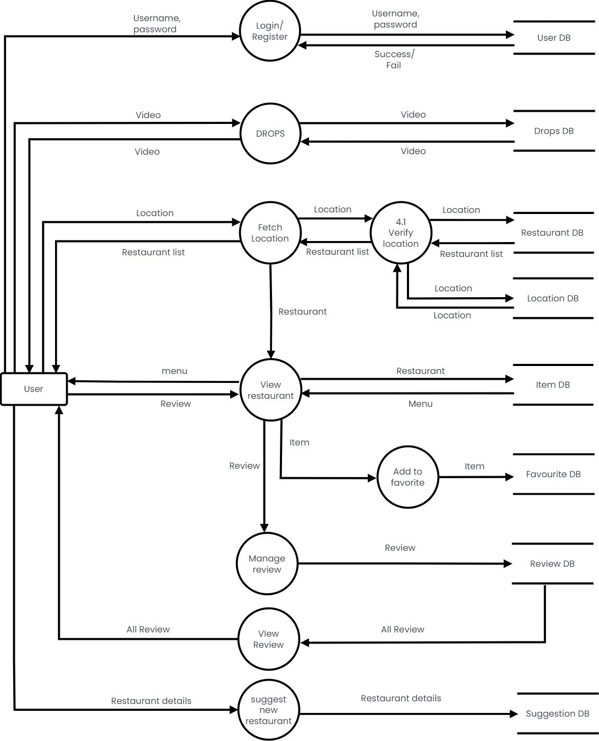
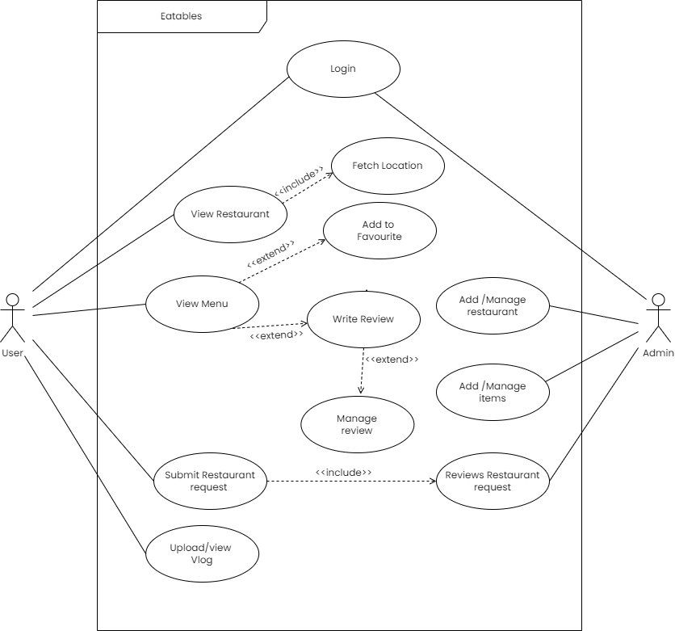
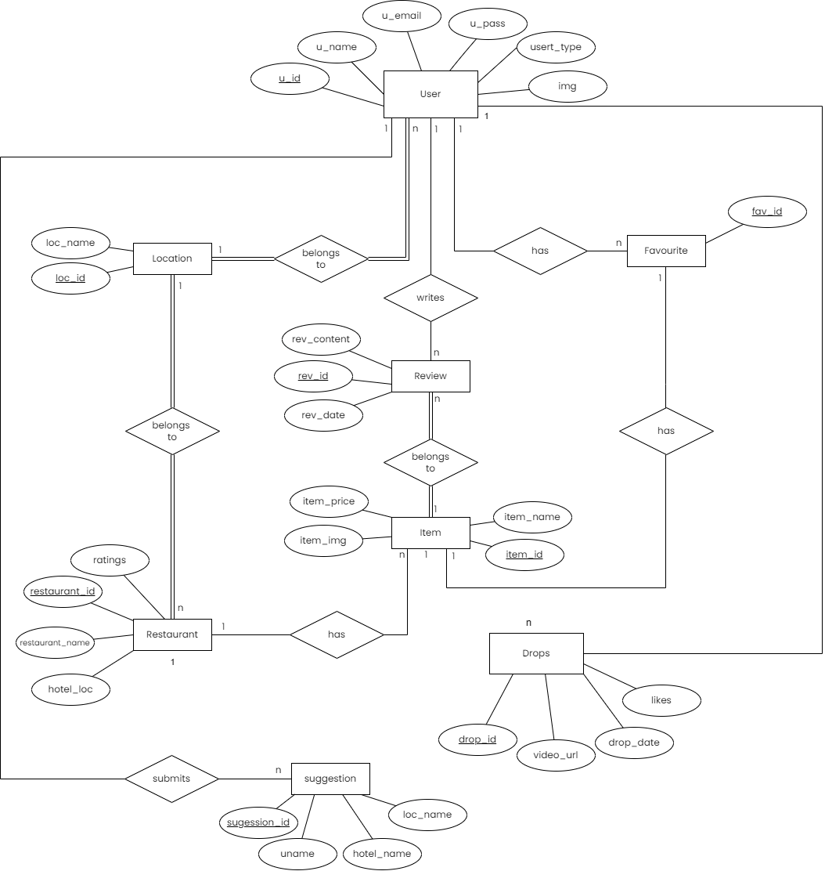
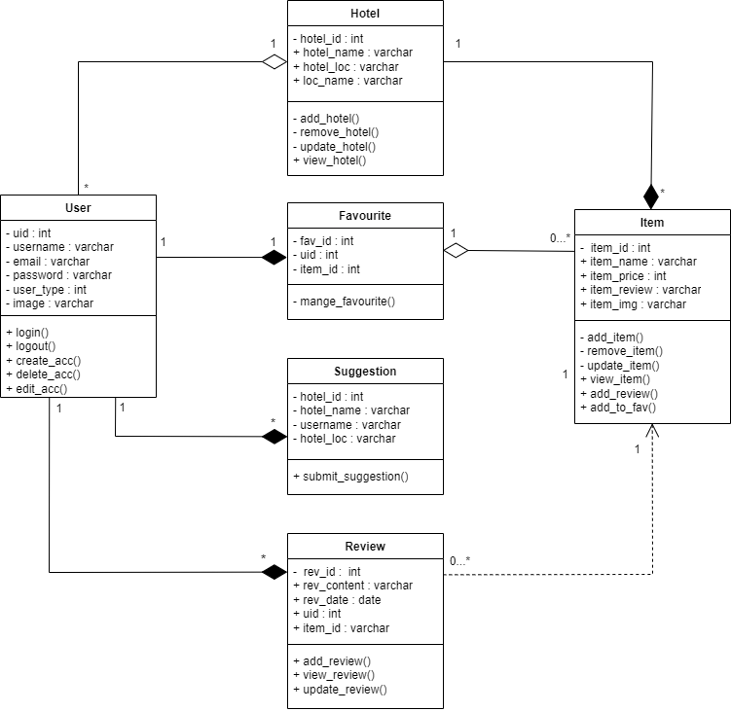
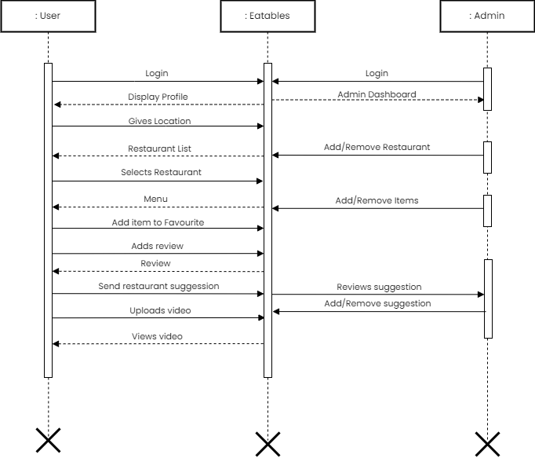
USECASE
DIAGRAM
ER
DIAGRAM
DFD
CONCLUSION
INTRODUCTION
KEY FEATURES
eatables
eatables
eatables
eatables
eatables
eatables
eatables
eatables
eatables
eatables
eatables
eatables
eatables
DOCUMENTATIONS
eatables
eatables
eatables
eatables
eatables
eatables
eatables
eatables
eatables
eatables
eatables
eatables
eatables
eatables
eatables
eatables
eatables
eatables
eatables
eatables
eatables
eatables
eatables
eatables
eatables
eatables
eatables
eatables
eatables
eatables
eatables
eatables
eatables
eatables
eatables
eatables
eatables
eatables
eatables
eatables
SYNOPSIS
SRS
DIAGRAMS
TESTCASES
eatables
eatables
eatables
eatables
eatables
eatables
eatables
eatables
eatables
eatables
eatables
eatables
eatables
eatables
eatables
eatables
eatables
eatables
eatables
eatables
eatables
eatables
eatables
eatables
eatables
eatables
eatables
eatables
eatables
eatables
eatables
eatables
eatables
eatables
eatables
eatables
Abstract
EATABLES is a location-based food discovery platform that allows users to explore and find new dining options. Users can access information about nearby restaurants, including contact details, location, and reviews from other users. They can leave their own reviews, add food items to favorites, and upload food vlog videos through the "drops" feature. The platform offers filtered search results based on price and allows users to submit new restaurant additions for review by the admin. EATABLES aims to provide a comprehensive and engaging experience for users to discover, share, and review food options in their area.
CLASS DIAGRAM
SEQUENCE DIAGRAM

Slide 39
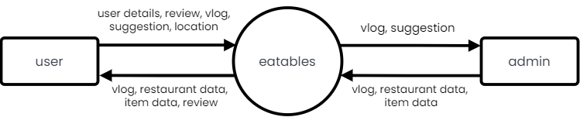
SRS
DIAGRAMS
TESTCASES
DOCUMENTATIONS
eatables
eatables
eatables
eatables
eatables
eatables
eatables
eatables
eatables
DIAGRAMS
eatables
eatables
eatables
eatables
eatables
eatables
eatables
eatables
ER
DIAGRAM
DFD
USECASE
DIAGRAM
eatables
eatables
eatables
eatables
eatables
eatables
eatables
eatables
CLASS DIAGRAM
SEQUENCE DIAGRAM
eatables
eatables
eatables
eatables
eatables
eatables
eatables
eatables
eatables
eatables
eatables
eatables
eatables
eatables
eatables
eatables
eatables
eatables
eatables
eatables

Slide 40
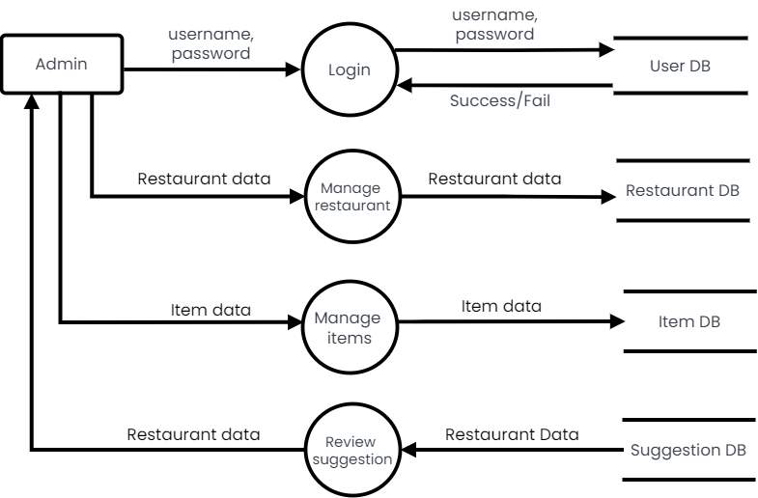
CLASS DIAGRAM
SEQUENCE DIAGRAM
SRS
DIAGRAMS
TESTCASES
DIAGRAMS
DOCUMENTATIONS
eatables
eatables
eatables
eatables
eatables
eatables
eatables
eatables
eatables
DFD
eatables
eatables
eatables
eatables
LEVEL 0 DFD OR (CONTEXT FLOW DIAGRAM)
eatables
eatables
eatables
eatables
eatables
eatables
eatables
eatables
eatables
eatables
eatables
eatables
eatables
eatables
eatables
eatables
eatables
eatables
eatables
eatables
eatables
eatables
eatables
eatables
eatables
eatables
eatables
eatables
eatables
eatables
eatables
eatables
ER
DIAGRAM
USECASE
DIAGRAM

Slide 41
CLASS DIAGRAM
SEQUENCE DIAGRAM
DIAGRAMS
DOCUMENTATIONS
eatables
eatables
eatables
eatables
eatables
eatables
eatables
eatables
eatables
DFD
eatables
eatables
eatables
eatables
LEVEL 1 DFD (ADMIN)
eatables
eatables
eatables
eatables
eatables
eatables
eatables
eatables
eatables
eatables
eatables
eatables
eatables
eatables
eatables
eatables
eatables
eatables
eatables
eatables
eatables
eatables
eatables
eatables
eatables
eatables
eatables
eatables
eatables
eatables
eatables
eatables
ER
DIAGRAM
USECASE
DIAGRAM

Slide 42
CLASS DIAGRAM
SEQUENCE DIAGRAM
SRS
DIAGRAMS
TESTCASES
DIAGRAMS
DOCUMENTATIONS
eatables
eatables
eatables
eatables
eatables
eatables
eatables
eatables
eatables
DFD
eatables
eatables
eatables
eatables
LEVEL 1 DFD (USER)
eatables
eatables
eatables
eatables
eatables
eatables
eatables
eatables
eatables
eatables
eatables
eatables
eatables
eatables
eatables
eatables
eatables
eatables
eatables
eatables
eatables
eatables
eatables
eatables
eatables
eatables
eatables
eatables
eatables
eatables
eatables
eatables
ER
DIAGRAM
USECASE
DIAGRAM

Slide 43
SRS
DIAGRAMS
TESTCASES
DOCUMENTATIONS
eatables
eatables
eatables
eatables
eatables
eatables
eatables
eatables
eatables
DIAGRAMS
eatables
eatables
eatables
eatables
eatables
eatables
eatables
eatables
ER
DIAGRAM
DFD
USECASE
DIAGRAM
eatables
eatables
eatables
eatables
eatables
eatables
eatables
eatables
CLASS DIAGRAM
SEQUENCE DIAGRAM
eatables
eatables
eatables
eatables
eatables
eatables
eatables
eatables
eatables
eatables
eatables
eatables
eatables
eatables
eatables
eatables
eatables
eatables
eatables
eatables

Slide 44
SRS
DIAGRAMS
TESTCASES
DOCUMENTATIONS
eatables
eatables
eatables
eatables
eatables
eatables
eatables
eatables
eatables
DIAGRAMS
eatables
eatables
eatables
eatables
eatables
eatables
eatables
eatables
ER
DIAGRAM
DFD
USECASE
DIAGRAM
eatables
eatables
eatables
eatables
eatables
eatables
eatables
eatables
CLASS DIAGRAM
SEQUENCE DIAGRAM
eatables
eatables
eatables
eatables
eatables
eatables
eatables
eatables
eatables
eatables
eatables
eatables
eatables
eatables
eatables
eatables
eatables
eatables
eatables
eatables

Slide 45
SEQUENCE DIAGRAM
SRS
DIAGRAMS
TESTCASES
DIAGRAMS
DOCUMENTATIONS
eatables
eatables
eatables
eatables
eatables
eatables
eatables
eatables
eatables
CLASS DIAGRAM
eatables
eatables
eatables
eatables
eatables
eatables
eatables
eatables
eatables
eatables
eatables
eatables
eatables
eatables
eatables
eatables
eatables
eatables
eatables
eatables
eatables
eatables
eatables
eatables
eatables
eatables
eatables
eatables
eatables
eatables
eatables
eatables
eatables
eatables
eatables
eatables
Language(s) to be used
Front-end : HTML, CSS & JavaScript
Back-end : PHP
Database : MySQL
DFD
ER
DIAGRAM
USECASE
DIAGRAM

Slide 46
SRS
DIAGRAMS
TESTCASES
DOCUMENTATIONS
eatables
eatables
eatables
eatables
eatables
eatables
eatables
eatables
eatables
DIAGRAMS
eatables
eatables
eatables
eatables
eatables
eatables
eatables
eatables
ER
DIAGRAM
DFD
USECASE
DIAGRAM
eatables
eatables
eatables
eatables
eatables
eatables
eatables
eatables
CLASS DIAGRAM
SEQUENCE DIAGRAM
eatables
eatables
eatables
eatables
eatables
eatables
eatables
eatables
eatables
eatables
eatables
eatables
eatables
eatables
eatables
eatables
eatables
eatables
eatables
eatables

Slide 47
SRS
DIAGRAMS
TESTCASES
DOCUMENTATIONS
eatables
eatables
eatables
eatables
eatables
eatables
eatables
eatables
eatables
DIAGRAMS
eatables
eatables
eatables
eatables
eatables
eatables
eatables
eatables
ER
DIAGRAM
DFD
USECASE DIAGRAM
eatables
eatables
eatables
eatables
eatables
eatables
eatables
eatables
CLASS DIAGRAM
SEQUENCE DIAGRAM
eatables
eatables
eatables
eatables
eatables
eatables
eatables
eatables
eatables
eatables
eatables
eatables
eatables
eatables
eatables
eatables
eatables
eatables
eatables
eatables

Slide 48
DFD
SEQUENCE DIAGRAM
SRS
DIAGRAMS
TESTCASES
DIAGRAMS
DOCUMENTATIONS
eatables
eatables
eatables
eatables
eatables
eatables
eatables
eatables
eatables
USECASE DIAGRAM
eatables
eatables
eatables
eatables
eatables
eatables
eatables
eatables
eatables
eatables
eatables
eatables
eatables
eatables
eatables
eatables
eatables
eatables
eatables
eatables
eatables
eatables
eatables
eatables
eatables
eatables
eatables
eatables
eatables
eatables
eatables
eatables
eatables
eatables
eatables
eatables
ER
DIAGRAM
CLASS DIAGRAM

Slide 49
SRS
DIAGRAMS
TESTCASES
DOCUMENTATIONS
eatables
eatables
eatables
eatables
eatables
eatables
eatables
eatables
eatables
DIAGRAMS
eatables
eatables
eatables
eatables
eatables
eatables
eatables
eatables
ER
DIAGRAM
DFD
USECASE DIAGRAM
eatables
eatables
eatables
eatables
eatables
eatables
eatables
eatables
CLASS DIAGRAM
SEQUENCE DIAGRAM
eatables
eatables
eatables
eatables
eatables
eatables
eatables
eatables
eatables
eatables
eatables
eatables
eatables
eatables
eatables
eatables
eatables
eatables
eatables
eatables

Slide 50
SRS
DIAGRAMS
TESTCASES
DOCUMENTATIONS
eatables
eatables
eatables
eatables
eatables
eatables
eatables
eatables
eatables
DIAGRAMS
eatables
eatables
eatables
eatables
eatables
eatables
eatables
eatables
ER
DIAGRAM
DFD
DFD
USECASE DIAGRAM
eatables
eatables
eatables
eatables
eatables
eatables
eatables
eatables
CLASS DIAGRAM
SEQUENCE DIAGRAM
eatables
eatables
eatables
eatables
eatables
eatables
eatables
eatables
eatables
eatables
eatables
eatables
eatables
eatables
eatables
eatables
eatables
eatables
eatables
eatables

Slide 51
USECASE DIAGRAM
SRS
DIAGRAMS
TESTCASES
DIAGRAMS
DOCUMENTATIONS
eatables
eatables
eatables
eatables
eatables
eatables
eatables
eatables
eatables
SEQUENCE DIAGRAM
eatables
eatables
eatables
eatables
eatables
eatables
eatables
eatables
DFD
eatables
eatables
eatables
eatables
eatables
eatables
eatables
eatables
ER
DIAGRAM
eatables
eatables
eatables
eatables
eatables
eatables
eatables
eatables
eatables
eatables
eatables
eatables
eatables
eatables
eatables
eatables
eatables
eatables
eatables
eatables
CLASS DIAGRAM

Slide 52
SRS
DIAGRAMS
TESTCASES
DOCUMENTATIONS
eatables
eatables
eatables
eatables
eatables
eatables
eatables
eatables
eatables
DIAGRAMS
eatables
eatables
eatables
eatables
eatables
eatables
eatables
eatables
ER
DIAGRAM
DFD
DFD
USECASE DIAGRAM
eatables
eatables
eatables
eatables
eatables
eatables
eatables
eatables
CLASS DIAGRAM
SEQUENCE DIAGRAM
eatables
eatables
eatables
eatables
eatables
eatables
eatables
eatables
eatables
eatables
eatables
eatables
eatables
eatables
eatables
eatables
eatables
eatables
eatables
eatables

Slide 53
SRS
DIAGRAMS
TESTCASES
DOCUMENTATIONS
eatables
eatables
eatables
eatables
eatables
eatables
eatables
eatables
eatables
DIAGRAMS
eatables
eatables
eatables
eatables
eatables
eatables
eatables
eatables
ER DIAGRAM
DFD
DFD
USECASE DIAGRAM
eatables
eatables
eatables
eatables
eatables
eatables
eatables
eatables
CLASS DIAGRAM
SEQUENCE DIAGRAM
eatables
eatables
eatables
eatables
eatables
eatables
eatables
eatables
eatables
eatables
eatables
eatables
eatables
eatables
eatables
eatables
eatables
eatables
eatables
eatables

Slide 54
USECASE DIAGRAM
SRS
DIAGRAMS
TESTCASES
DIAGRAMS
DOCUMENTATIONS
eatables
eatables
eatables
eatables
eatables
eatables
eatables
eatables
eatables
ER DIAGRAM
eatables
eatables
eatables
eatables
eatables
eatables
eatables
eatables
eatables
eatables
eatables
eatables
DFD
eatables
eatables
eatables
eatables
eatables
eatables
eatables
eatables
eatables
eatables
eatables
eatables
eatables
eatables
eatables
eatables
eatables
eatables
eatables
eatables
eatables
eatables
eatables
eatables
SEQUENCE DIAGRAM
CLASS DIAGRAM

Slide 55
SYNOPSIS
SRS
TESTCASES
SRS
SYNOPSIS
DOCUMENTATIONS
eatables
eatables
eatables
eatables
eatables
eatables
eatables
eatables
eatables
DIAGRAMS
eatables
eatables
eatables
eatables
eatables
eatables
eatables
eatables
ER DIAGRAM
DFD
DFD
USECASE DIAGRAM
eatables
eatables
eatables
eatables
eatables
eatables
eatables
eatables
CLASS DIAGRAM
SEQUENCE DIAGRAM
eatables
eatables
eatables
eatables
eatables
eatables
eatables
eatables
eatables
eatables
eatables
eatables
eatables
eatables
eatables
eatables
eatables
eatables
eatables
eatables

Slide 56
DFD
USECASE DIAGRAM
CONCLUSION
INTRODUCTION
KEY FEATURES
eatables
eatables
eatables
eatables
eatables
eatables
eatables
eatables
eatables
eatables
eatables
eatables
eatables
DOCUMENTATIONS
eatables
eatables
eatables
eatables
eatables
eatables
eatables
eatables
eatables
eatables
eatables
eatables
eatables
eatables
eatables
eatables
ER DIAGRAM
eatables
eatables
eatables
eatables
eatables
eatables
eatables
eatables
eatables
eatables
eatables
eatables
eatables
eatables
eatables
eatables
eatables
eatables
eatables
eatables
eatables
eatables
eatables
eatables
SYNOPSIS
SRS
DIAGRAMS
TESTCASES
eatables
eatables
eatables
eatables
eatables
eatables
eatables
eatables
eatables
eatables
eatables
eatables
eatables
eatables
eatables
eatables
eatables
eatables
eatables
eatables
eatables
eatables
eatables
eatables
eatables
eatables
eatables
eatables
eatables
eatables
eatables
eatables
eatables
eatables
eatables
eatables
Abstract
EATABLES is a location-based food discovery platform that allows users to explore and find new dining options. Users can access information about nearby restaurants, including contact details, location, and reviews from other users. They can leave their own reviews, add food items to favorites, and upload food vlog videos through the "drops" feature. The platform offers filtered search results based on price and allows users to submit new restaurant additions for review by the admin. EATABLES aims to provide a comprehensive and engaging experience for users to discover, share, and review food options in their area.
CLASS DIAGRAM
SEQUENCE DIAGRAM

Slide 57
DFD
USECASE DIAGRAM
CONCLUSION
INTRODUCTION
KEY FEATURES
eatables
eatables
eatables
eatables
eatables
eatables
eatables
eatables
eatables
eatables
eatables
eatables
eatables
DOCUMENTATIONS
eatables
eatables
eatables
eatables
eatables
eatables
eatables
eatables
eatables
eatables
eatables
eatables
eatables
eatables
eatables
eatables
ER DIAGRAM
eatables
eatables
eatables
eatables
eatables
eatables
eatables
eatables
eatables
eatables
eatables
eatables
DIAGRAMS
eatables
eatables
eatables
eatables
eatables
eatables
eatables
eatables
eatables
eatables
eatables
eatables
SYNOPSIS
SRS
DIAGRAMS
TESTCASES
eatables
eatables
eatables
eatables
eatables
eatables
eatables
eatables
eatables
eatables
eatables
eatables
eatables
eatables
eatables
eatables
eatables
eatables
eatables
eatables
eatables
eatables
eatables
eatables
eatables
eatables
eatables
eatables
eatables
eatables
eatables
eatables
eatables
eatables
eatables
eatables
Abstract
EATABLES is a location-based food discovery platform that allows users to explore and find new dining options. Users can access information about nearby restaurants, including contact details, location, and reviews from other users. They can leave their own reviews, add food items to favorites, and upload food vlog videos through the "drops" feature. The platform offers filtered search results based on price and allows users to submit new restaurant additions for review by the admin. EATABLES aims to provide a comprehensive and engaging experience for users to discover, share, and review food options in their area.
CLASS DIAGRAM
SEQUENCE DIAGRAM

Slide 58
DOCUMENTATIONS
eatables
eatables
eatables
eatables
eatables
eatables
eatables
eatables
eatables
TESTCASES
eatables
eatables
eatables
eatables
Test Case ID | Test Condition | Expected Output | Result
1 | If all field empty | Fill all the credentials | Success
2 | If full name field empty | Please enter your full name | Success
3 | If username field empty | Please enter your user name | Success
4 | If email field empty | Please enter your email address | Success
5 | If password field empty | Please enter a password | Success
6 | If password confirm field empty | Please confirm your password | Success
7 | If full name field consist number/special characters | Only alphabets and whitespaces are allowed | Success
8 | If username field consist of less than 4 or greater than 15 characters | Username requires 4 – 15 characters | Success
9 | If user name field consist number/special characters/whitespace/uppercase | Only lowercase letters are allowed | Success
10 | If user name field consist of existing username | Username already taken | Success
11 | If email field consist of invalid email | Invalid email format | Success
12 | If email field consisting of existing email | Account already exist for this email | Success
13 | If password field consist of less than 8 characters | Minimum 8 characters required | Success
14 | If password field does not contain combination of number and letter | Combination of alphabets and numbers required | Success
15 | If confirm password field does not match password field | Password entered does not match | Success
16 | If all credentials are valid | Account created successfully and redirect to login page. | Success
Signup form
eatables
eatables
eatables
eatables
eatables
eatables
eatables
eatables
eatables
eatables
eatables
eatables
eatables
eatables
eatables
eatables
eatables
eatables
eatables
eatables
eatables
eatables
eatables
eatables
eatables
eatables
eatables
eatables
eatables
eatables
eatables
eatables

Slide 59
SRS
DIAGRAMS
TESTCASES
DOCUMENTATIONS
eatables
eatables
eatables
eatables
eatables
eatables
eatables
eatables
eatables
TESTCASES
eatables
eatables
eatables
eatables
Login form
eatables
eatables
eatables
eatables
eatables
eatables
eatables
eatables
Test Case ID | Test Condition | Expected Output | Result
1 | If username field empty | Please fill out this field | Success
2 | If password field empty | Please fill out this field | Success
3 | If inputs wrong username | User not found | Success
4 | If inputs wrong password | Password incorrect | Success
5 | If user clicks on forgot password | Redirect to reset password page | Success
6 | If username and password are valid for user | Redirect to user home page | Success
7 | If username and password are valid for admin | Redirect to admin profile page | Success
eatables
eatables
eatables
eatables
eatables
eatables
eatables
eatables
eatables
eatables
eatables
eatables
eatables
eatables
eatables
eatables
eatables
eatables
eatables
eatables
eatables
eatables
eatables
eatables
Test Case ID | Test Condition | Expected Output | Result
1 | If all field empty | Fill all the credentials | Success
2 | If full name field empty | Please enter your full name | Success
3 | If username field empty | Please enter your user name | Success
4 | If email field empty | Please enter your email address | Success
5 | If password field empty | Please enter a password | Success
6 | If password confirm field empty | Please confirm your password | Success
7 | If full name field consist number/special characters | Only alphabets and whitespaces are allowed | Success
8 | If username field consist of less than 4 or greater than 15 characters | Username requires 4 – 15 characters | Success
9 | If user name field consist number/special characters/whitespace/uppercase | Only lowercase letters are allowed | Success
10 | If user name field consist of existing username | Username already taken | Success
11 | If email field consist of invalid email | Invalid email format | Success
12 | If email field consisting of existing email | Account already exist for this email | Success
13 | If password field consist of less than 8 characters | Minimum 8 characters required | Success
14 | If password field does not contain combination of number and letter | Combination of alphabets and numbers required | Success
15 | If confirm password field does not match password field | Password entered does not match | Success
16 | If all credentials are valid | Account created successfully and redirect to login page. | Success

Slide 60
SRS
DIAGRAMS
TESTCASES
DOCUMENTATIONS
eatables
eatables
eatables
eatables
eatables
eatables
eatables
eatables
eatables
TESTCASES
eatables
eatables
eatables
eatables
eatables
eatables
eatables
eatables
Home page
eatables
eatables
eatables
eatables
eatables
eatables
eatables
eatables
Test Case ID | Test Condition | Expected Output | Result
1 | If user types restaurant name in search box. | Display similar restaurant names under search box | Success
2 | If user clicks on eatables logo. | Page refreshes | Success
3 | If user clicks on Drops icon | Redirect to Drops page | Success
4 | If user clicks on profile icon | Redirect to user profile page | Success
5 | If user chooses a restaurant name | Redirect to item details page | Success
6 | If user click on assistant | Open filter window | Success
7 | If user applies price filter | Display items based on the price | Success
8 | If user clicks on Submit restaurant in footer | Redirect to restaurant suggestion page | Success
eatables
eatables
eatables
eatables
eatables
eatables
eatables
eatables
eatables
eatables
eatables
eatables
eatables
eatables
eatables
eatables
eatables
eatables
eatables
eatables
Test Case ID | Test Condition | Expected Output | Result
1 | If username field empty | Please fill out this field | Success
2 | If password field empty | Please fill out this field | Success
3 | If inputs wrong username | User not found | Success
4 | If inputs wrong password | Password incorrect | Success
5 | If user clicks on forgot password | Redirect to reset password page | Success
6 | If username and password are valid for user | Redirect to user home page | Success
7 | If username and password are valid for admin | Redirect to admin profile page | Success

Slide 61
SRS
DIAGRAMS
TESTCASES
DOCUMENTATIONS
eatables
eatables
eatables
eatables
eatables
eatables
eatables
eatables
eatables
TESTCASES
eatables
eatables
eatables
eatables
eatables
eatables
eatables
eatables
Submit restaurant
eatables
eatables
eatables
eatables
eatables
eatables
eatables
eatables
TestCase ID | Test Condition | Expected Output | Result
1 | If restaurant name field empty | Display please fill out this field | Success
2 | If location field empty | Display please fill out this field | Success
3 | If ratings field empty | Display please fill out this field | Success
4 | If link field empty | Display please fill out this field | Success
5 | If description field empty | Display please fill out this field | Success
6 | If all fields are valid | Display submit message and redirect to user profile page | Success
eatables
eatables
eatables
eatables
eatables
eatables
eatables
eatables
eatables
eatables
eatables
eatables
eatables
eatables
eatables
eatables
eatables
eatables
eatables
eatables
Test Case ID | Test Condition | Expected Output | Result
1 | If user types restaurant name in search box. | Display similar restaurant names under search box | Success
2 | If user clicks on eatables logo. | Page refreshes | Success
3 | If user clicks on Drops icon | Redirect to Drops page | Success
4 | If user clicks on profile icon | Redirect to user profile page | Success
5 | If user chooses a restaurant name | Redirect to item details page | Success
6 | If user click on assistant | Open filter window | Success
7 | If user applies price filter | Display items based on the price | Success
8 | If user clicks on Submit restaurant in footer | Redirect to restaurant suggestion page | Success

Slide 62
SRS
DIAGRAMS
TESTCASES
DOCUMENTATIONS
eatables
eatables
eatables
eatables
eatables
eatables
eatables
eatables
eatables
TESTCASES
eatables
eatables
eatables
eatables
eatables
eatables
eatables
eatables
Hotel page
eatables
eatables
eatables
eatables
eatables
eatables
eatables
eatables
Test Case ID | Test Condition | Expected Output | Result
1 | If user clicks on contact number | Dial the contact number | Success
2 | If user clicks on email | Open gmail and compose a new mail | Success
3 | If user clicks/drags on map | Show location of the restaurant | Success
4 | If user clicks on zomato icon | Redirect to zomato page of the restaurant | Success
5 | If user clicks on an item | Redirect to item details page | Success
6 | If user clicks on number in pagination | Redirect to the page | Success
7 | If user clicks on eatables | Redirect to home page | Success
eatables
eatables
eatables
eatables
eatables
eatables
eatables
eatables
eatables
eatables
eatables
eatables
eatables
eatables
eatables
eatables
eatables
eatables
eatables
eatables
TestCase ID | Test Condition | Expected Output | Result
1 | If restaurant name field empty | Display please fill out this field | Success
2 | If location field empty | Display please fill out this field | Success
3 | If ratings field empty | Display please fill out this field | Success
4 | If link field empty | Display please fill out this field | Success
5 | If description field empty | Display please fill out this field | Success
6 | If all fields are valid | Display submit message and redirect to user profile page | Success

Slide 63
SRS
DIAGRAMS
TESTCASES
DOCUMENTATIONS
eatables
eatables
eatables
eatables
eatables
eatables
eatables
eatables
eatables
TESTCASES
eatables
eatables
eatables
eatables
eatables
eatables
eatables
eatables
Item page
eatables
eatables
eatables
eatables
eatables
eatables
eatables
eatables
Test Case ID | Test Condition | Expected Output | Result
1 | If user clicks on eatables | Redirect to home page | Success
2 | If user clicks on profile icon | Redirect to user profile page | Success
3 | If user clicks on add to favourite/remove favourite | Item is added/removed from favourites accordingly | Success
4 | If clicked on share icon | Website URL is copied to clipboard | Success
5 | If tried to submit empty review | Display please fill out this field | Success
6 | If user submits review | Store review and display it in the same page in the review section. | Success
7 | If user clicks on logout icon | Log out and redirect to login page | Success
eatables
eatables
eatables
eatables
eatables
eatables
eatables
eatables
eatables
eatables
eatables
eatables
eatables
eatables
eatables
eatables
eatables
eatables
eatables
eatables
Test Case ID | Test Condition | Expected Output | Result
1 | If user clicks on contact number | Dial the contact number | Success
2 | If user clicks on email | Open gmail and compose a new mail | Success
3 | If user clicks/drags on map | Show location of the restaurant | Success
4 | If user clicks on zomato icon | Redirect to zomato page of the restaurant | Success
5 | If user clicks on an item | Redirect to item details page | Success
6 | If user clicks on number in pagination | Redirect to the page | Success
7 | If user clicks on eatables | Redirect to home page | Success

Slide 64
SRS
DIAGRAMS
TESTCASES
DOCUMENTATIONS
eatables
eatables
eatables
eatables
eatables
eatables
eatables
eatables
eatables
TESTCASES
eatables
eatables
eatables
eatables
eatables
eatables
eatables
eatables
Drops page
eatables
eatables
eatables
eatables
eatables
eatables
eatables
eatables
Test Case ID | Test Condition | Expected Output | Result
1 | If user clicks on eatables | Redirect to home page | Success
2 | If user clicks on profile icon | Redirect to user profile page | Success
3 | If user clicks in home icon | Redirect to index page | Success
4 | If user clicks on heart icon | Like/dislike the video | Success
5 | If user click/tap in the video | Play/pause the video | Success
6 | If user click on the video icon | Open upload video window | Success
eatables
eatables
eatables
eatables
eatables
eatables
eatables
eatables
eatables
eatables
eatables
eatables
eatables
eatables
eatables
eatables
eatables
eatables
eatables
eatables
Test Case ID | Test Condition | Expected Output | Result
1 | If user clicks on eatables | Redirect to home page | Success
2 | If user clicks on profile icon | Redirect to user profile page | Success
3 | If user clicks on add to favourite/remove favourite | Item is added/removed from favourites accordingly | Success
4 | If clicked on share icon | Website URL is copied to clipboard | Success
5 | If tried to submit empty review | Display please fill out this field | Success
6 | If user submits review | Store review and display it in the same page in the review section. | Success
7 | If user clicks on logout icon | Log out and redirect to login page | Success

Slide 65
SRS
DIAGRAMS
TESTCASES
DOCUMENTATIONS
eatables
eatables
eatables
eatables
eatables
eatables
eatables
eatables
eatables
TESTCASES
eatables
eatables
eatables
eatables
eatables
eatables
eatables
eatables
User profile
eatables
eatables
eatables
eatables
Test Case ID | Test Condition | Expected Output | Result
1 | If clicked on eatables | Redirect to home page | Success
2 | If clicked on drop icon | Redirect to drops page | Success
3 | If clicked on video icon | Open drop upload window | Success
4 | If clicked on logout icon | Log out and redirect to login page | Success
5 | If clicked on camera icon | Redirect to edit profile page | Success
6 | If clicked on edit profile button | Redirect to edit profile page | Success
7 | If clicked on Favorites | Display items in user’s favorite list | Success
8 | If clicked on the delete icon on the favorite item | Remove from favorite | Success
9 | If clicked on Drops | Display drops uploaded by the user | Success
10 | If clicked on Reviews | Display reviews uploaded by the user | Success
11 | If clicked on delete icon in reviews | Delete the review and redirect to the same page | Success
12 | If clicked on submit restaurant in footer | Redirect to restaurant suggest form page | Success
eatables
eatables
eatables
eatables
eatables
eatables
eatables
eatables
eatables
eatables
eatables
eatables
eatables
eatables
eatables
eatables
eatables
eatables
eatables
eatables
eatables
eatables
eatables
eatables
Test Case ID | Test Condition | Expected Output | Result
1 | If user clicks on eatables | Redirect to home page | Success
2 | If user clicks on profile icon | Redirect to user profile page | Success
3 | If user clicks in home icon | Redirect to index page | Success
4 | If user clicks on heart icon | Like/dislike the video | Success
5 | If user click/tap in the video | Play/pause the video | Success
6 | If user click on the video icon | Open upload video window | Success

Slide 66
DIAGRAMS
SRS
DIAGRAMS
TESTCASES
DOCUMENTATIONS
eatables
eatables
eatables
eatables
eatables
eatables
eatables
eatables
eatables
TESTCASES
eatables
eatables
eatables
eatables
eatables
eatables
eatables
eatables
Admin panel
eatables
eatables
eatables
eatables
SYNOPSIS
eatables
eatables
eatables
eatables
Test Case ID | Test Condition | Expected Output | Result
1 | If clicked on add new restaurant | Display form to add new restaurant | Success
2 | If clicked on manage restaurant | Display list of all restaurants with edit and delete button | Success
3 | If clicked on add item | Display form to add new item | Success
4 | If clicked on user suggestion | Display all restaurant suggestions submitted by different users | Success
5 | If clicked on admin logo | Redirect to admin profile page | Success
eatables
eatables
eatables
eatables
eatables
eatables
eatables
eatables
eatables
eatables
eatables
eatables
eatables
eatables
eatables
eatables
eatables
eatables
eatables
eatables
Test Case ID | Test Condition | Expected Output | Result
1 | If clicked on eatables | Redirect to home page | Success
2 | If clicked on drop icon | Redirect to drops page | Success
3 | If clicked on video icon | Open drop upload window | Success
4 | If clicked on logout icon | Log out and redirect to login page | Success
5 | If clicked on camera icon | Redirect to edit profile page | Success
6 | If clicked on edit profile button | Redirect to edit profile page | Success
7 | If clicked on Favorites | Display items in user’s favorite list | Success
8 | If clicked on the delete icon on the favorite item | Remove from favorite | Success
9 | If clicked on Drops | Display drops uploaded by the user | Success
10 | If clicked on Reviews | Display reviews uploaded by the user | Success
11 | If clicked on delete icon in reviews | Delete the review and redirect to the same page | Success
12 | If clicked on submit restaurant in footer | Redirect to restaurant suggest form page | Success
SRS

Slide 67
DFD
USECASE DIAGRAM
CONCLUSION
INTRODUCTION
KEY FEATURES
eatables
eatables
eatables
eatables
eatables
eatables
eatables
eatables
eatables
DOCUMENTATIONS
eatables
eatables
eatables
eatables
eatables
eatables
eatables
eatables
ER DIAGRAM
eatables
eatables
eatables
eatables
eatables
eatables
eatables
eatables
eatables
eatables
eatables
eatables
SYNOPSIS
SRS
DIAGRAMS
TESTCASES
eatables
eatables
eatables
eatables
eatables
eatables
eatables
eatables
eatables
eatables
eatables
eatables
eatables
eatables
eatables
eatables
Abstract
EATABLES is a location-based food discovery platform that allows users to explore and find new dining options. Users can access information about nearby restaurants, including contact details, location, and reviews from other users. They can leave their own reviews, add food items to favorites, and upload food vlog videos through the "drops" feature. The platform offers filtered search results based on price and allows users to submit new restaurant additions for review by the admin. EATABLES aims to provide a comprehensive and engaging experience for users to discover, share, and review food options in their area.
CLASS DIAGRAM
SEQUENCE DIAGRAM

Slide 68
eatables
eatables
eatables
eatables
eatables
eatables
eatables
eatables
eatables
eatables
eatables
eatables
eatables
eatables
eatables
eatables
eatables
Our platform is built using HTML, JavaScript, and Tailwind CSS for the frontend, and PHP and MySQL for the backend. This powerful combination of technologies ensures that our platform is user-friendly, responsive, and efficient.
We integrated the Geolocation API to retrieve the user's location and provide location-based recommendations.
eatables
eatables
eatables
KEY FEATURES
CONCLUSION
INTRODUCTION
eatables
DOCUMENTATIONS
eatables
eatables
eatables
eatables
eatables
eatables
eatables
eatables
eatables
eatables
eatables
eatables
eatables
eatables
eatables
eatables
eatables
eatables
204682 – Ashwin K.V
204683 – Darshan Dinesh M.P
204684 – Delbin George
eatables
eatables
eatables
eatables
eatables
eatables
SYNOPSIS
SYNOPSIS
SRS
DIAGRAMS
TESTCASES
SRS

Slide 69
eatables
eatables
eatables
eatables
eatables
eatables
eatables
eatables
eatables
eatables
eatables
eatables
eatables
eatables
eatables
eatables
eatables
User reviews and ratings for restaurants
Detailed restaurant information, including contact details and address
Personalized favorites list for easy reference
"Drops" feature for users to upload and share food vlog videos
Restaurant submission feature for users to suggest new restaurants
Admin panel for managing restaurant information and review user submitted suggestions
Mobile-friendly platform for easy access on-the-go
Our platform is built using HTML, JavaScript, and Tailwind CSS for the frontend, and PHP and MySQL for the backend. This powerful combination of technologies ensures that our platform is user-friendly, responsive, and efficient.
We integrated the Geolocation API to retrieve the user's location and provide location-based recommendations.
eatables
eatables
INTRODUCTION
KEY FEATURES
CONCLUSION
eatables
eatables
DOCUMENTATIONS
eatables
eatables
eatables
eatables
eatables
eatables
eatables
eatables
eatables
eatables
eatables
eatables
eatables
eatables
eatables
eatables
eatables
eatables
204682 – Ashwin K.V
204683 – Darshan Dinesh M.P
204684 – Delbin George
eatables
eatables
eatables
eatables
eatables
eatables
EATABLES is a user-friendly platform that offers a seamless dining experience, providing users with a one-stop solution for exploring new food options. The platform's innovative features, including geolocation-based restaurant suggestions, community-driven reviews, and personalized favorites lists, make it easy for users to find the perfect dining spot based on their preferences. With its user-centric design and advanced technology, EATABLES is the ultimate tool for anyone looking to discover new culinary delights.

Slide 70
INTRODUCTION
KEY FEATURES
eatables
eatables
eatables
eatables
eatables
eatables
eatables
eatables
eatables
CONCLUSION
eatables
eatables
eatables
eatables
EATABLES is a user-friendly platform that offers a seamless dining experience, providing users with a one-stop solution for exploring new food options. The platform's innovative features, including geolocation-based restaurant suggestions, community-driven reviews, and personalized favorites lists, make it easy for users to find the perfect dining spot based on their preferences. With its user-centric design and advanced technology, EATABLES is the ultimate tool for anyone looking to discover new culinary delights.
eatables
eatables
eatables
eatables
eatables
eatables
eatables
eatables
DOCUMENTATIONS
eatables
eatables
eatables
eatables
eatables
eatables
eatables
eatables
eatables
eatables
eatables
eatables
eatables
eatables
eatables
eatables
eatables
eatables
eatables
eatables
eatables
eatables
eatables
eatables

Slide 71

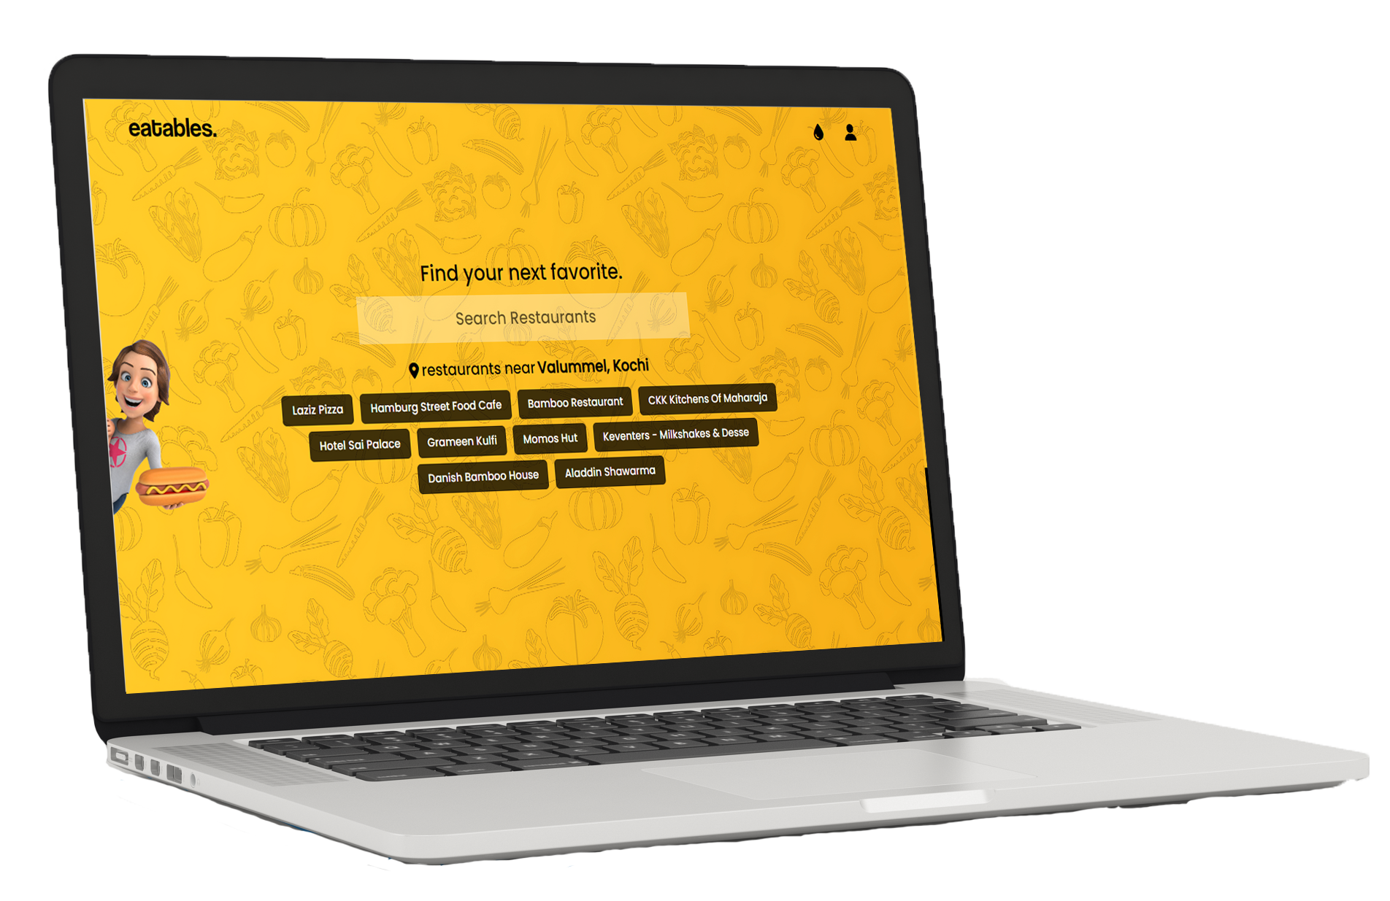

eatables
eatables
eatables
eatables
eatables
eatables
eatables
eatables
eatables
eatables
eatables
eatables
eatables
User reviews and ratings for restaurants
Detailed restaurant information, including contact details and address
Personalized favorites list for easy reference
"Drops" feature for users to upload and share food vlog videos
Restaurant submission feature for users to suggest new restaurants
Admin panel for managing restaurant information and review user submitted suggestions
Mobile-friendly platform for easy access on-the-go
Our platform is built using HTML, JavaScript, and Tailwind CSS for the frontend, and PHP and MySQL for the backend. This powerful combination of technologies ensures that our platform is user-friendly, responsive, and efficient.
We integrated the Geolocation API to retrieve the user's location and provide location-based recommendations.
INTRODUCTION
KEY FEATURES
eatables
CONCLUSION
eatables
eatables
DOCUMENTATIONS
eatables
eatables
eatables
eatables
eatables
eatables
eatables
eatables
eatables
eatables
eatables
eatables
eatables
eatables
eatables
eatables
eatables
eatables
204682 – Ashwin K.V
204683 – Darshan Dinesh M.P
204684 – Delbin George
eatables
eatables
eatables
eatables
eatables
eatables
eatables
eatables
eatables
eatables
eatables
eatables
Lets go.....
EATABLES is a user-friendly platform that offers a seamless dining experience, providing users with a one-stop solution for exploring new food options. The platform's innovative features, including geolocation-based restaurant suggestions, community-driven reviews, and personalized favorites lists, make it easy for users to find the perfect dining spot based on their preferences. With its user-centric design and advanced technology, EATABLES is the ultimate tool for anyone looking to discover new culinary delights.

Slide 72
eatables
eatables
eatables
eatables
eatables
eatables
eatables
eatables
eatables
eatables
eatables
eatables
CONCLUSION
INTRODUCTION
eatables
eatables
eatables
eatables
eatables
eatables
eatables
eatables
eatables
eatables
eatables
eatables
eatables
eatables
eatables
eatables
eatables
eatables
eatables
eatables
eatables
eatables
eatables
eatables
eatables
eatables
eatables
eatables
eatables
Lets go.....
eatables
eatables
eatables
eatables
KEY FEATURES
TECHNOLOGY USED

